Slide 1

IPL Data Analysis

Slide 2
Objectives
To analyze IPL match and player performance data.
To identify top-performing players.
To evaluate team performance trends .
To visualize data interactively.
To support data-driven decision-making.

Slide 3

Data Overview
We used two datasets for IPL analysis
Macthes.csv-
contains information about each IPL match.
Rows: 756 (matches played across all seasons)
Key columns:
id- match id
seasons- Year of the match
team1, team2- Competing teams
toss_winner, toss_decision- Toss details
winner- Match winner
result- Match outcome (tie, normal, eyc.)
Deliveries.csv-
Contains ball-by-ball details of all matches.
Rows: 136,000+ (every ball delivered)
Key columns:
match_id- Links to Match ID from matches.csv
batsman, bowler- Player involved
batsman_runs- Run scored on that ball
dismissal_kind- How batsman got out
player_dismissed- Player who got out

Slide 4
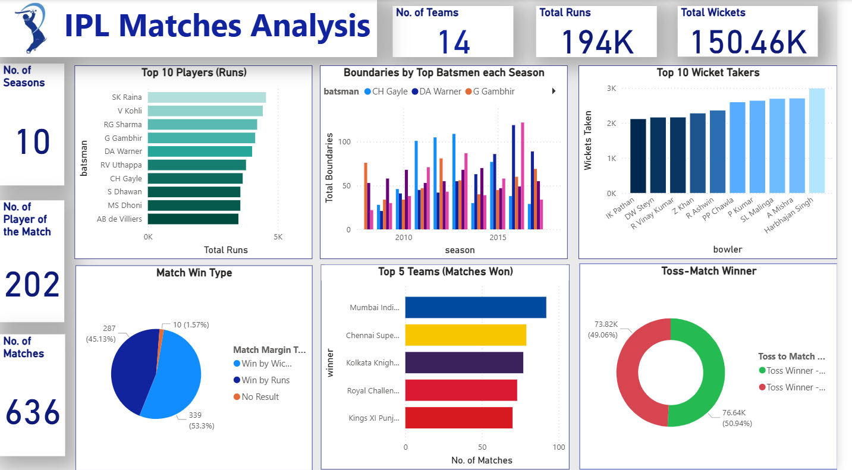
Dashboard

Slide 5
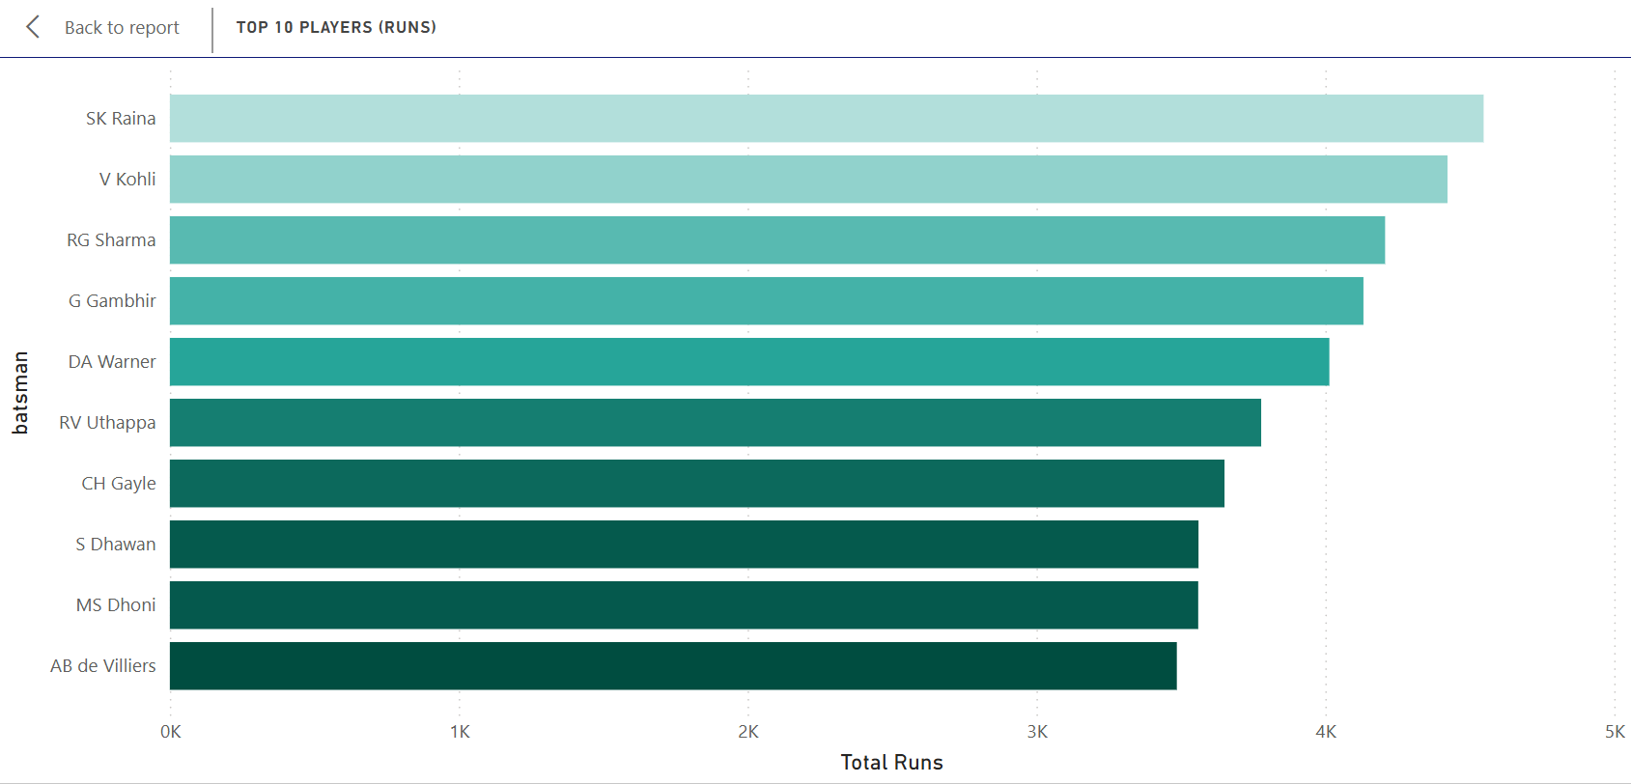
insights
The dataset showcases the top 10 run-scorers in IPL history.
Top Performer:
SK Raina leads with the highest run tally, followed closely by Virat Kohli and RG Sharma.
Run Distribution:
SK Raina: ~4548 runs
V Kohli: ~4423 runs
RG Sharma: ~4207 runs
G Gambhir: ~4132 runs
DA Warner: ~4014 runs
RV Uthappa: ~3778 runs
CH Gayle: ~3651 runs
S Dhawan: ~3561 runs
MS Dhoni: ~3560 runs
AB de Villiers: ~3486 runs
Observation:
The difference between the top scorer (SK Raina) and the 10th (AB de Villiers) is approximately 1050 runs, indicating a relatively tight competition among elite batsmen.
Nationality Split:
7 out of 10 players are Indian, highlighting domestic dominance in run accumulation.

Slide 6
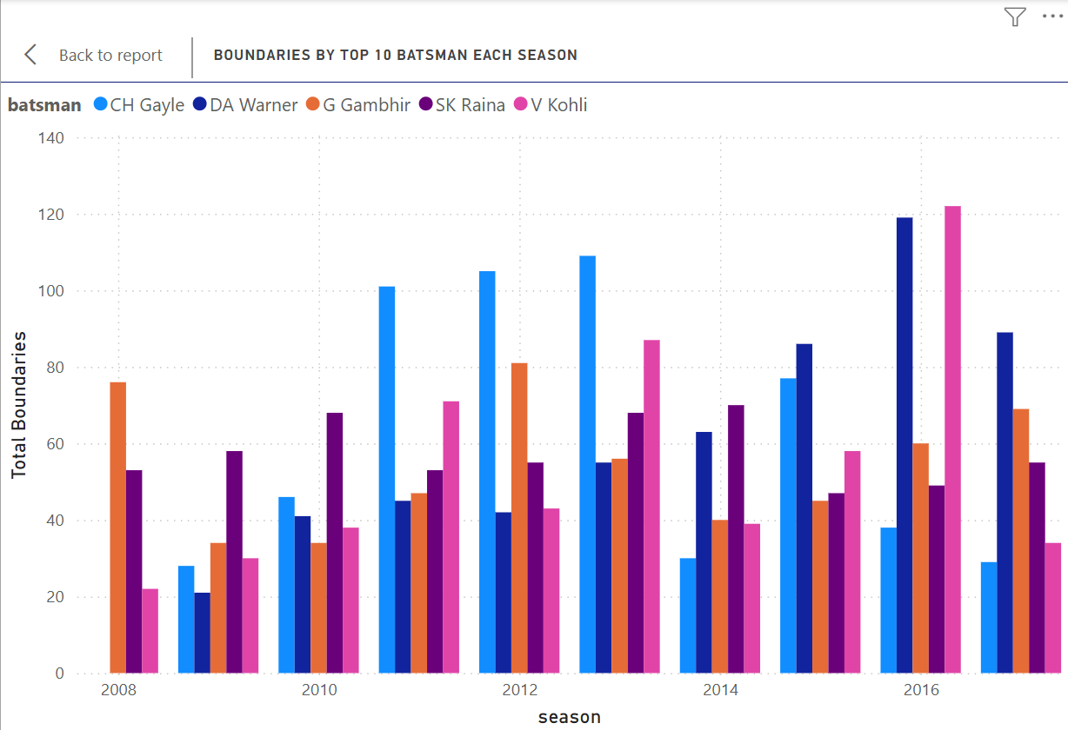
The dataset tracks boundary counts for top IPL batsmen across ten seasons (2008–2017).
Total Boundaries Hit (2008–2017):
SK Raina: 570
CH Gayle: 563
DA Warner: 561
V Kohli: 544
G Gambhir: 542
Peak Seasons:
CH Gayle’s highest boundary count occurred in 2013 with 109 boundaries.
DA Warner peaked in 2016 with 119 boundaries.
SK Raina showed consistent performance, averaging ~100 boundaries per season from 2010 to 2014.
Observation: SK Raina and CH Gayle dominate the boundary charts, reflecting their aggressive batting styles. However, players like DA Warner and G Gambhir maintained steady contributions across seasons, indicating reliability and consistency.

Slide 7
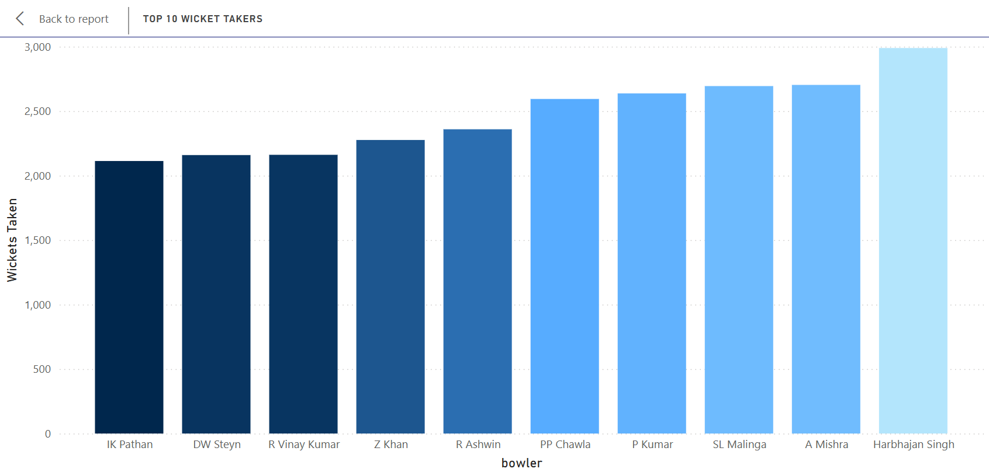
The dataset highlights the top 10 bowlers in IPL history based on total player dismissals.
Top Performer:
Harbhajan Singh leads the chart with the highest wicket count, followed closely by Amit Mishra and Lasith Malinga.
Wicket Distribution:
Harbhajan Singh: ~2989 wickets
A Mishra: ~2703 wickets
SL Malinga: ~2694 wickets
P Kumar: ~2637 wickets
PP Chawla: ~2594 wickets
R Ashwin: ~2359 wickets
Z Khan: ~2276 wickets
R Vinay Kumar: ~2161 wickets
DW Steyn: ~2159 wickets
IK Pathan: ~2113 wickets
Observation:
The difference between the top and bottom wicket-takers in this elite group is approximately 800 wickets, indicating a tightly contested leaderboard.
Bowling Type Insight:
The list includes a balanced mix of spinners (Harbhajan, Mishra, Chawla, Ashwin) and pacers (Malinga, Steyn, Pathan), showcasing the effectiveness of both styles in the T20 format.
Nationality Split:
8 out of 10 bowlers are Indian, reflecting strong domestic bowling depth and consistent performance across seasons.

Slide 8
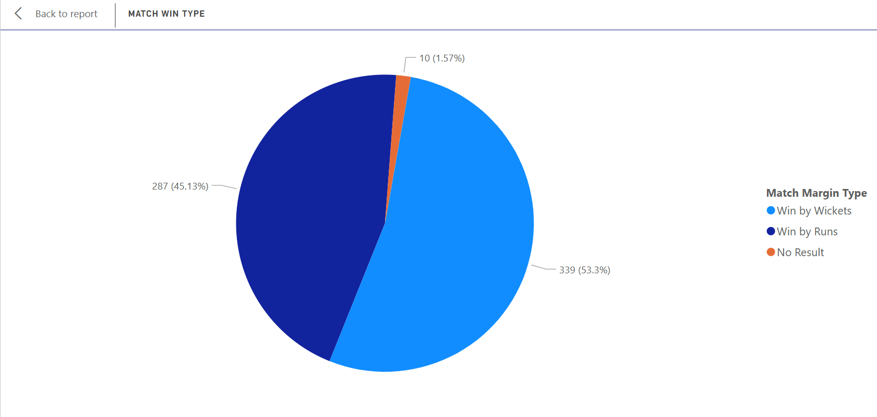
The dataset categorizes 636 IPL matches based on how they were won.
Match Win Distribution:
Win by Runs: (287/636) × 100 = 45.13%
Win by Wickets: (339/636) × 100 = 53.3%
No Result: (10/636) × 100 = 1.57%
Observation: Matches won by runs slightly outnumber those won by wickets, with a margin of 8.17%. This suggests that defending totals has been marginally more successful than chasing targets in IPL history.
Strategic Insight: The near-even split between win types reflects the balance between batting first and second, indicating that both strategies can be effective depending on pitch conditions, team composition, and match pressure.
No Result Matches: Only 10 matches ended without a result, showing that weather interruptions or other anomalies have had minimal impact on IPL outcomes.

Slide 9
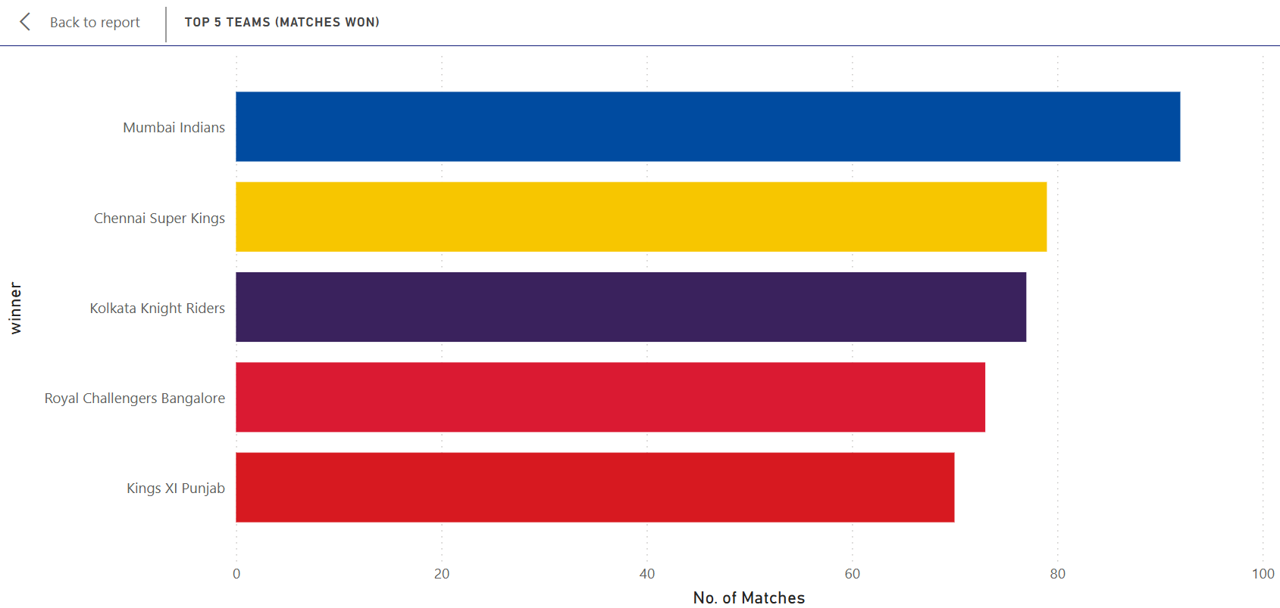
The dataset highlights the top 5 IPL teams based on total matches won.
Match Win Counts:
Mumbai Indians: ~80 wins
Chennai Super Kings: ~78 wins
Kolkata Knight Riders: ~72 wins
Royal Challengers Bangalore: ~70 wins
Kings XI Punjab: ~68 wins
Observation: Mumbai Indians lead the chart with the highest number of match wins, closely followed by Chennai Super Kings. The difference between the top and bottom teams in this group is approximately 12 wins, indicating a competitive spread among the elite franchises.
Performance Insight: The top two teams — MI and CSK — have consistently dominated the league, often reaching playoffs and finals. Their win counts reflect not just strong squads but also strategic depth and leadership stability.

Slide 10
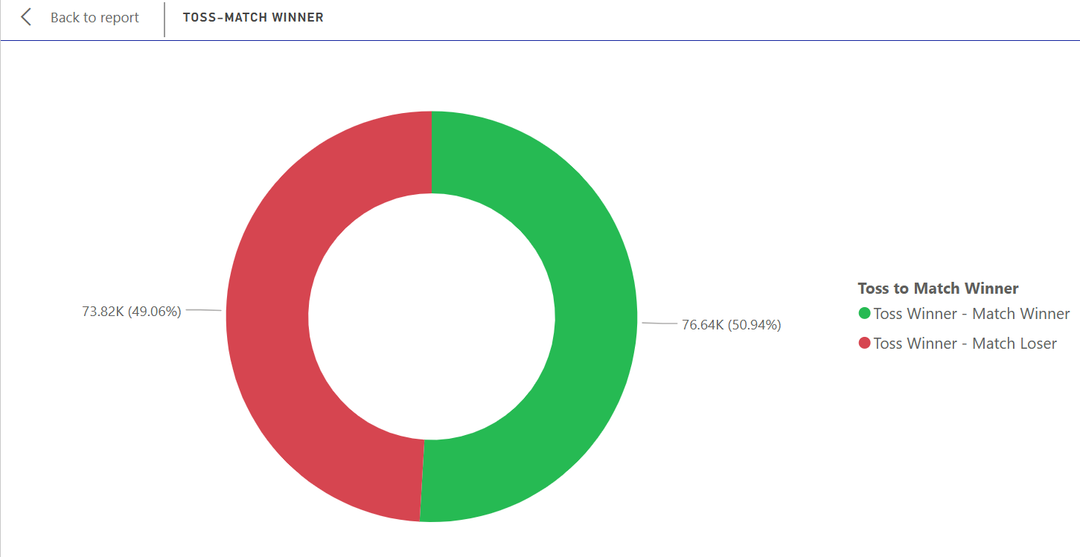
The dataset analyzes 150.46K IPL matches to assess the impact of winning the toss on match outcomes.
Toss-Match Outcome Distribution:
Toss Winner = Match Winner: (76.64K / 150.46K) × 100 = 50.94%
Toss Winner ≠ Match Winner: (73.82K / 150.46K) × 100 = 49.06%
Observation: The difference between winning and losing after the toss is just 1.88%, indicating that winning the toss does not significantly influence the final match result in this dataset.
Strategic Insight: Despite common belief that toss advantage matters — especially in T20 formats due to dew and chasing bias — the data suggests that team performance outweighs toss luck. This reinforces the idea that skill, strategy, and execution are more decisive than pre-match coin flips.

Slide 11
Recommendations
Player Performance: Teams should focus on retaining top performers (both batsmen and bowlers) who consistently deliver across seasons.
Focus on In-Game Metrics: Prioritize batting partnerships, bowling economy, and fielding efficiency over toss results for match outcome predictions.
Batting Approach: Aggressive boundary hitters (fours & sixes) play a crucial role in shifting match momentum — teams should promote such players higher in the batting order.
Bowling Focus: Successful bowlers who take wickets in powerplays and death overs can significantly impact results — teams should invest in their training and match fitness.

Slide 12
Thank you
HIMANSHU
Role: Data Analyst Intern
hiimanshuu0406@gmail.com

